Slide 1
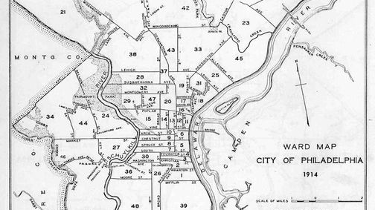
Waste in Philadelphia
Group project

Slide 2
Business Problem and Questions

Slide 3
Data Sources

Slide 4
Machine LEARNING Model

Slide 5
Database & Dashboard

Slide 6
Validate the problem

